Slide 1


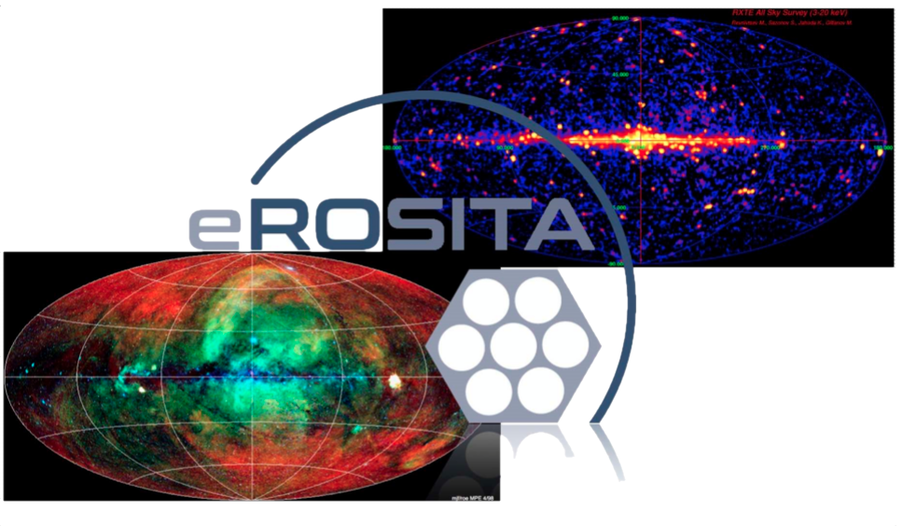

Популяция рентгеновских двойных в Галактике. Применение методов ML к данным eROSITA DR1

Slide 2
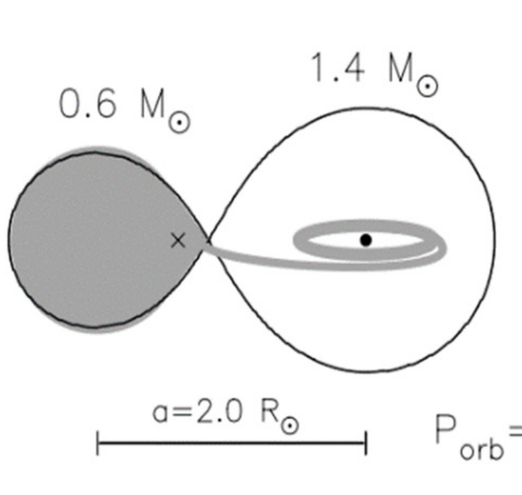
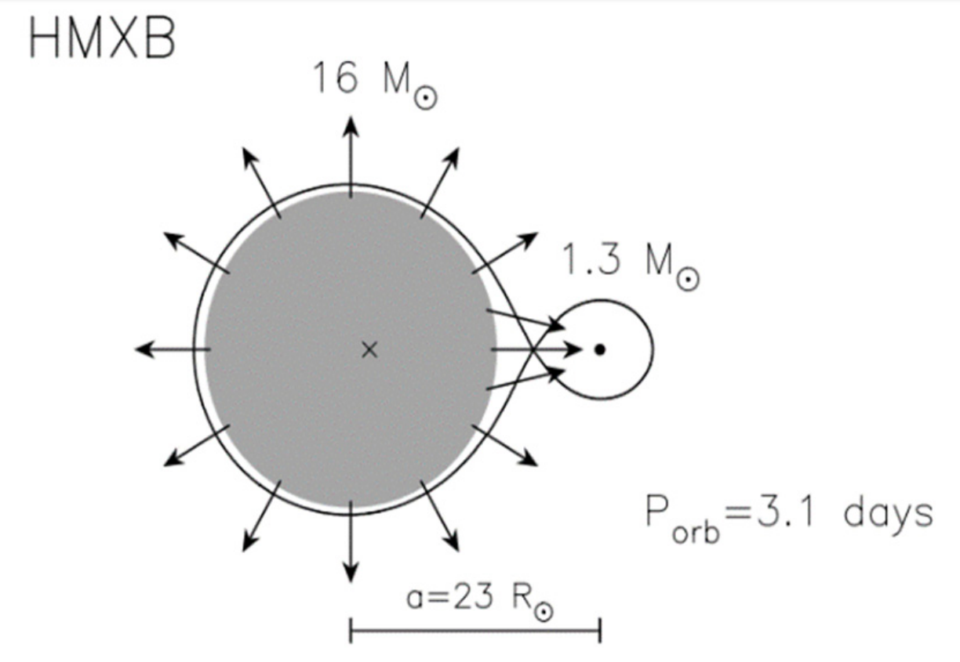
XRBs: LMXBs and HMXBs
LMXB
HMXB
LMXBs - older systems, less massive (M, K, G, sometimes A type)
HMXBs - younger and brighter concentrate towards the disk of the galaxy, massive early type counterparts (O-B type).
1

Slide 3
Spatial distribution of XRBs
Credit: https://www.cosmos.esa.int/web/integral/
Doroshenko et al (2014)
2

Slide 4
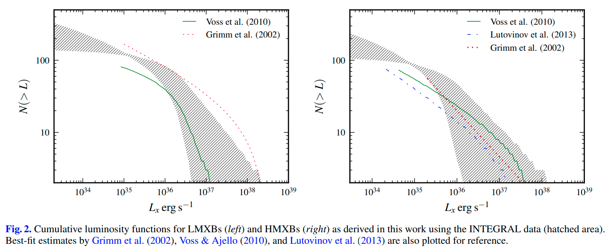
X-ray luminosity function (XLF)
Doroshenko et al (2014)
3

Slide 5
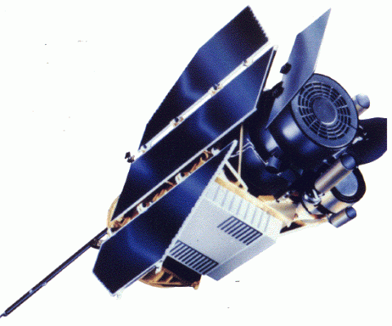
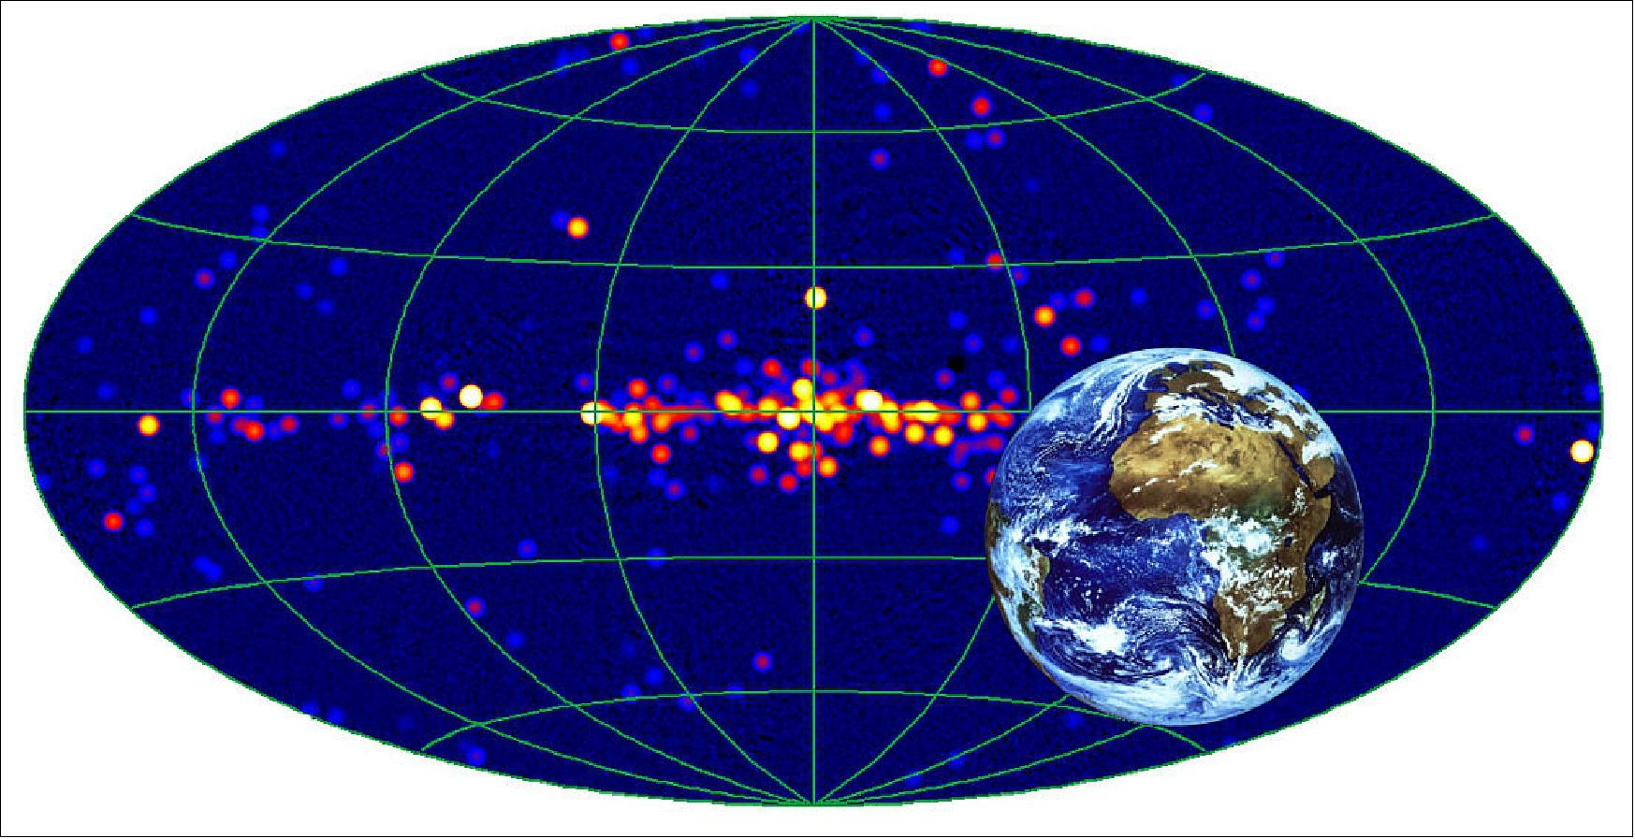
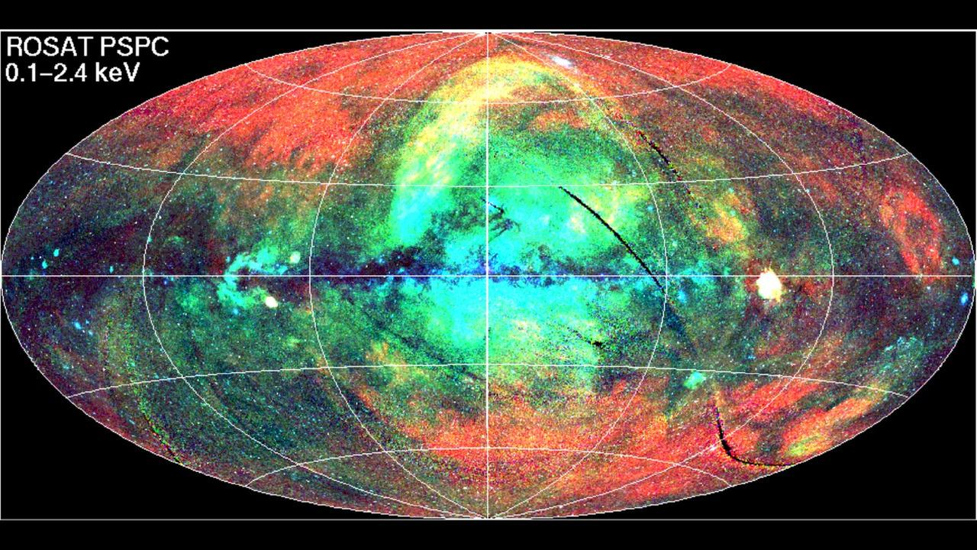
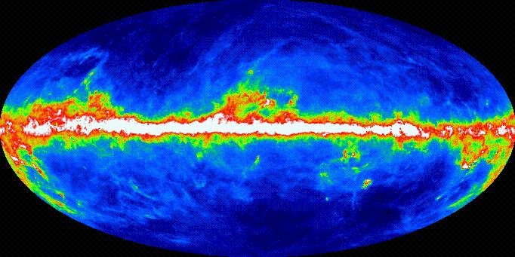
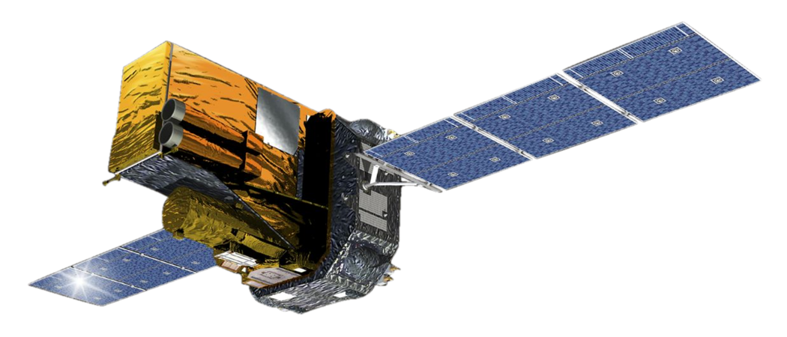
Detection of Galactic XRBs
Either low sensitivity or susceptible to absorption
4

Slide 6
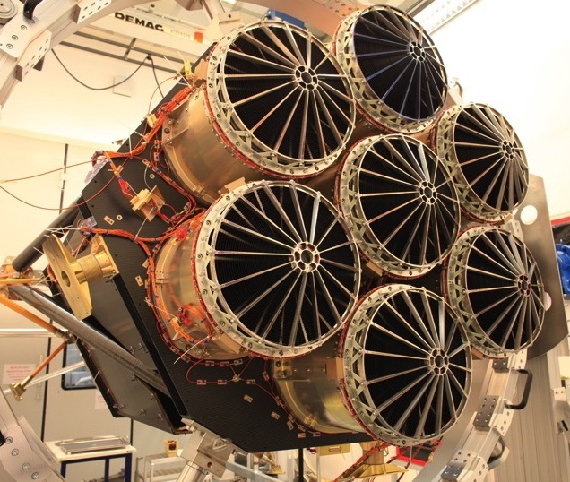
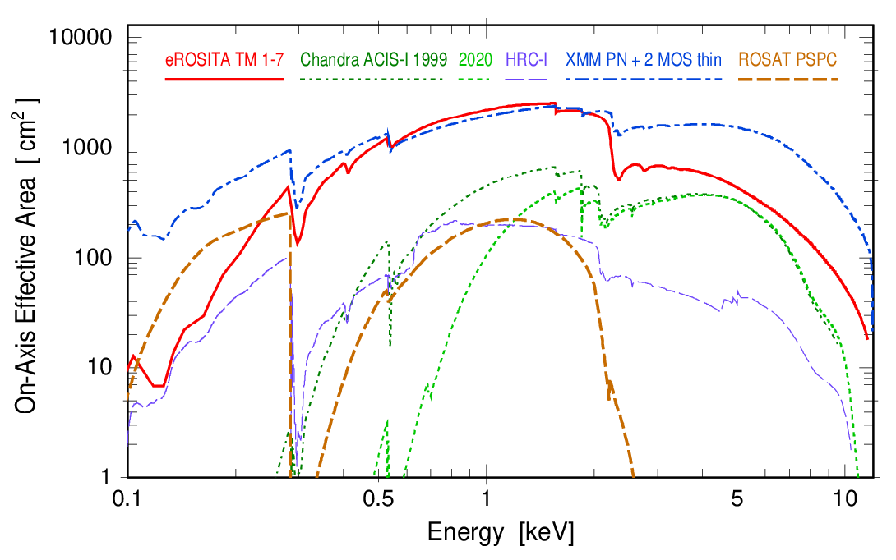
eROSITA all-sky X-ray survey
View of Galaxy Clusters A3391/A3395
Large Effective area (~1300 cm2 at 1keV ~ with XMM-Newton)
Large Field of view: 1 degree (diameter)
Positional accuracy: ~4.5” (1σ)
Spectral resolution at all measured energies within specs (~80eV at 1.5keV)
High sensitivity (~1e-14 erg/s/cm2 (0.5 ks) in ecliptic equatorial region)
Wide (in comparison with ROSAT) energy range (0.2-10 keV)
5

Slide 7
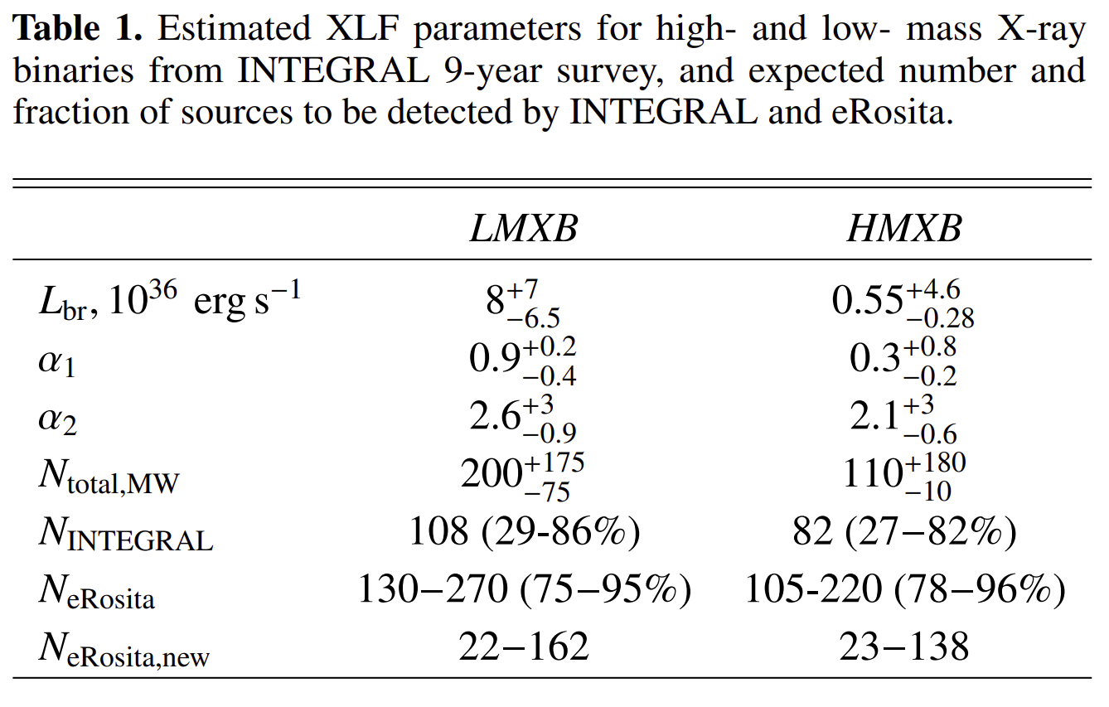
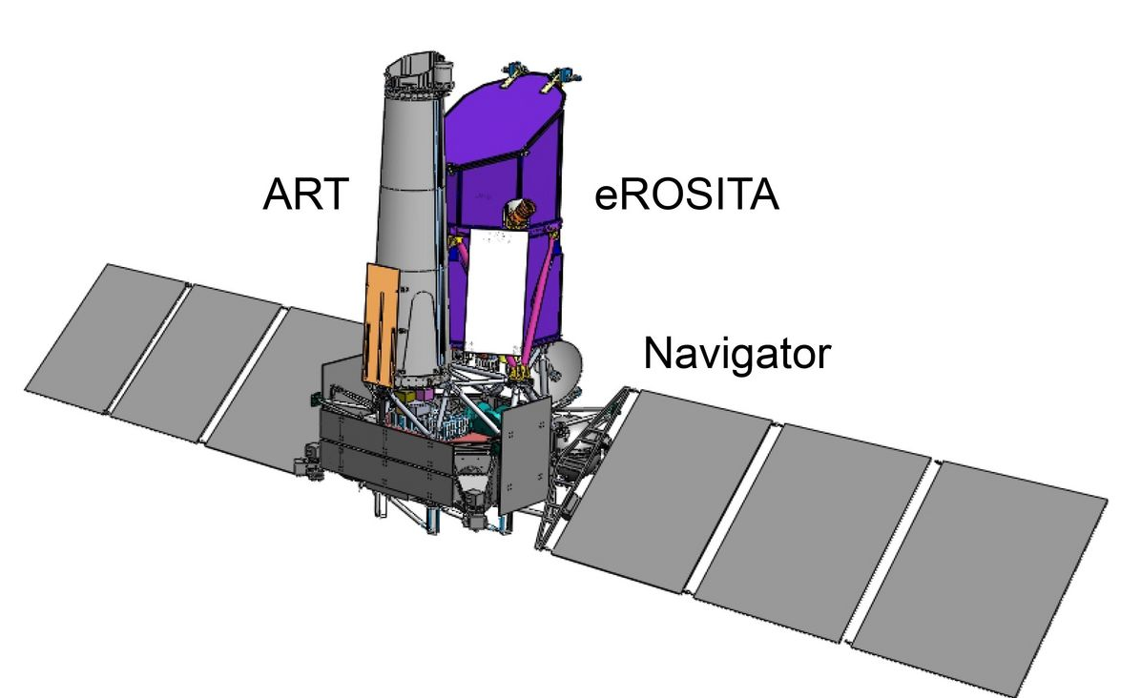
eROSITA. View of XRBs
~22-150
of new XRBs
on eROSITA_DE side
Doroshenko et al (2014)
6

Slide 8
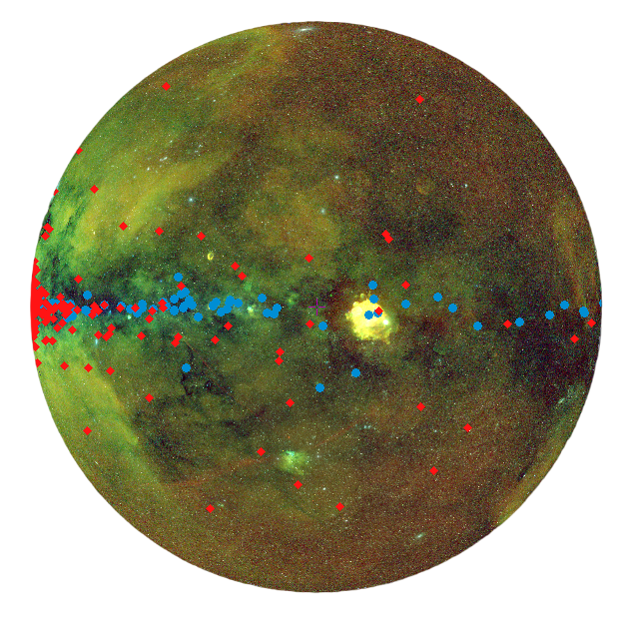
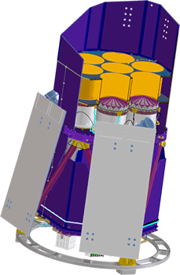
eROSITA DR1. View of XRBs
Around one million sources just in eRASS Data Release 1 !
(70% more than known X-ray sources before)
7

Slide 9
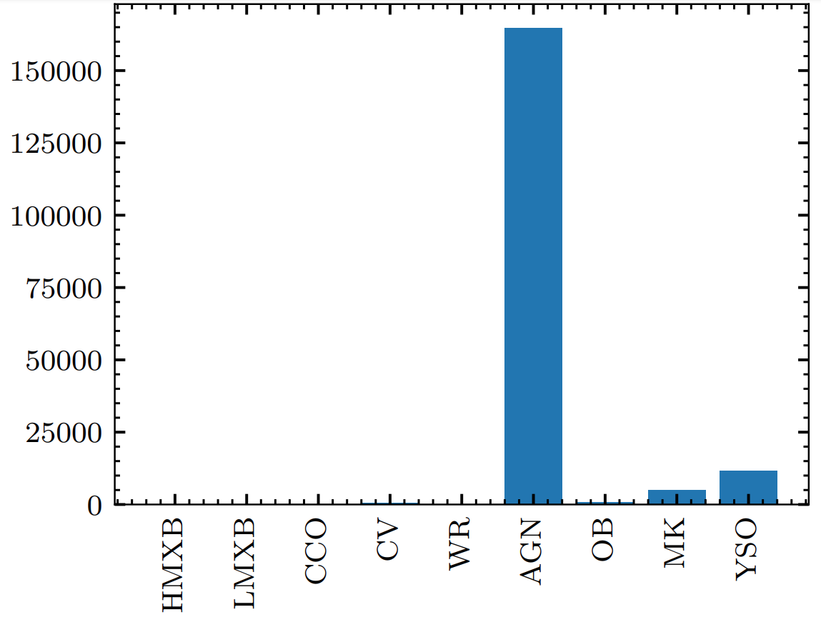
A needle in haystack problem for XRBs
Problem:
AGNs outnumber other X-ray
emitting class sources
Solution:
​Usage of Multiwavelength
(MWL)
data for classification
8

Slide 10
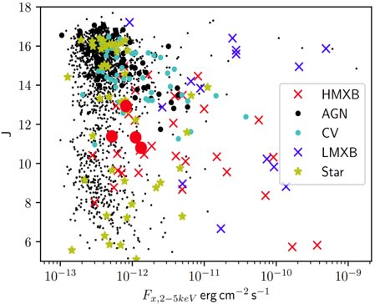
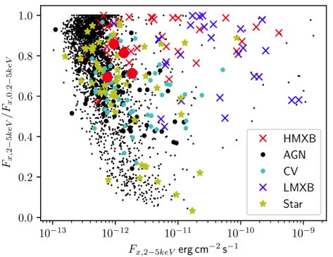
Classification of X-ray sources. MWL data
​Classification problem:
Properties of different class sources strongly overlap
9

Slide 11

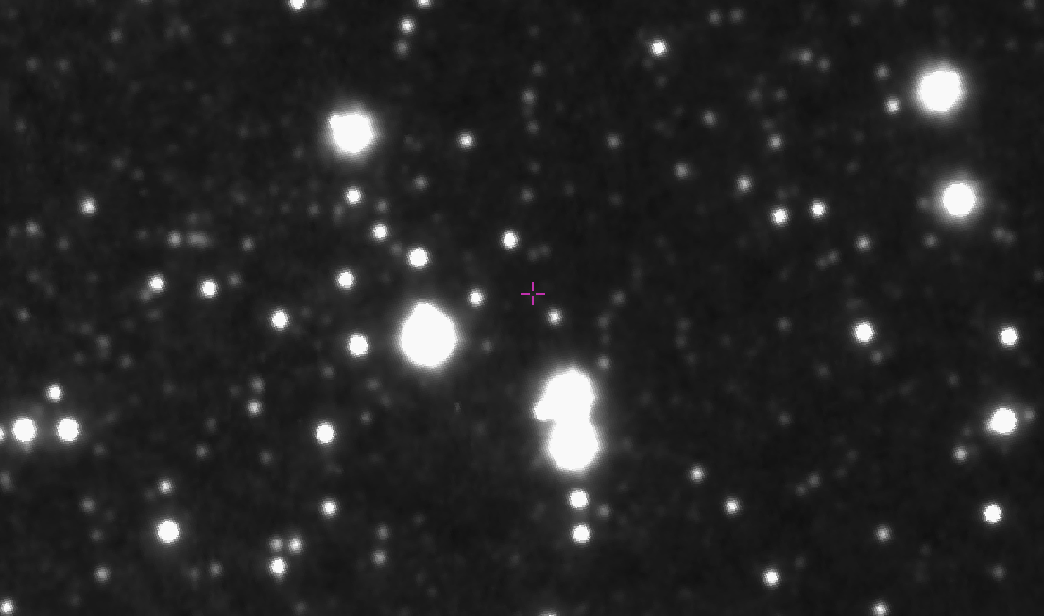
Identification of the optical counterpart
10''
XMM-Newton image
10''
Identification problem:​
​
High density of probable counterparts based on positional match alone
VVV J-band image
View of LMXB IGR J17451-3022
10

Slide 12
Machine Learning:
Random Forest and Classification
11

Slide 13
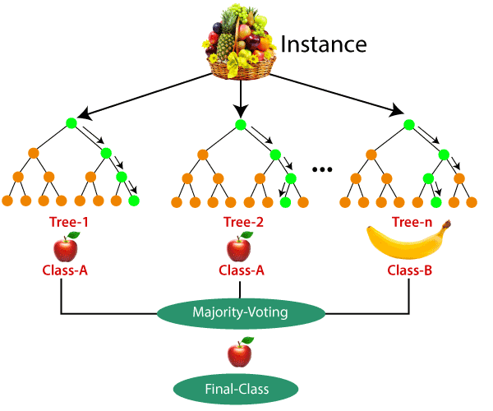
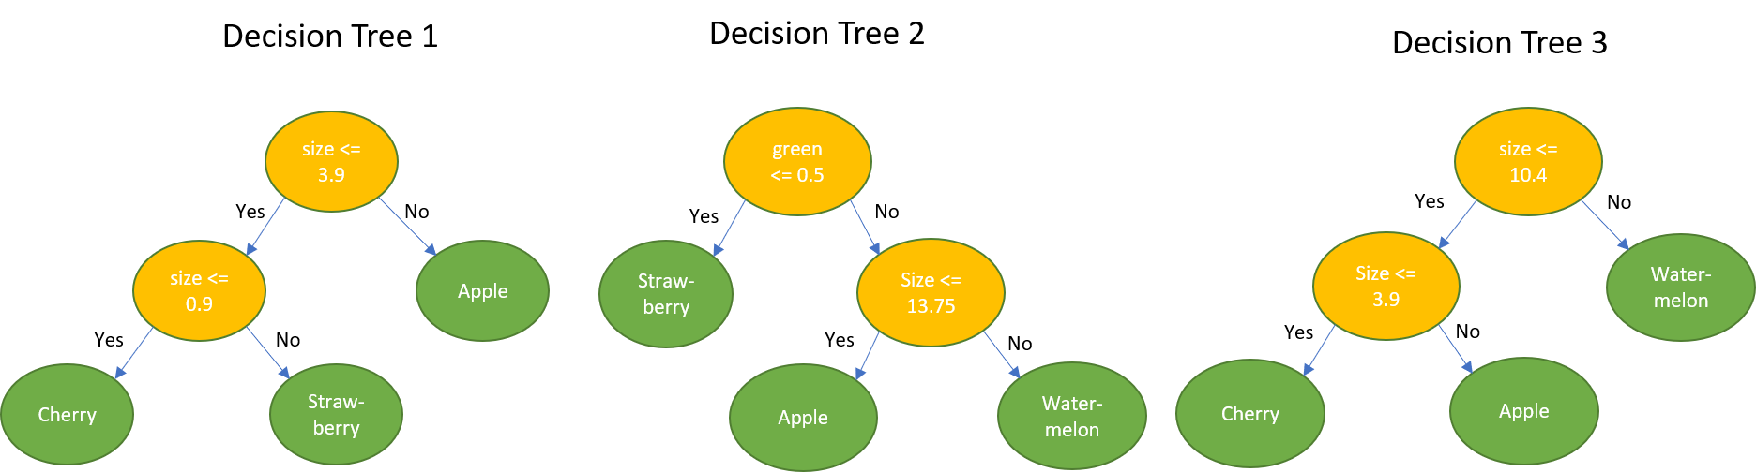
Machine learning. Decision trees
Each decision tree contains a certain set of conditions for specific features, the list of which is specified by the user
12

Slide 14
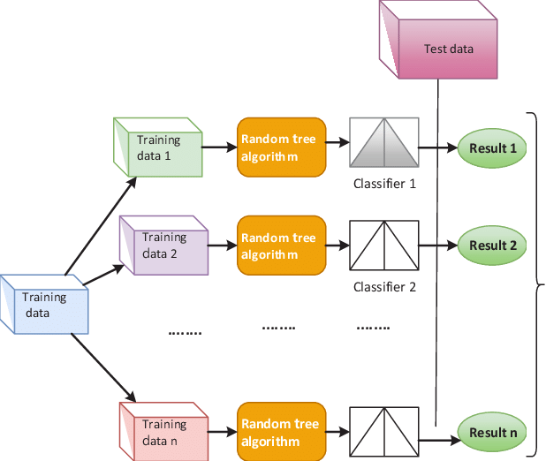
Machine learning. Datasets
All labelled data
is divided into test
and training datasets
13

Slide 15
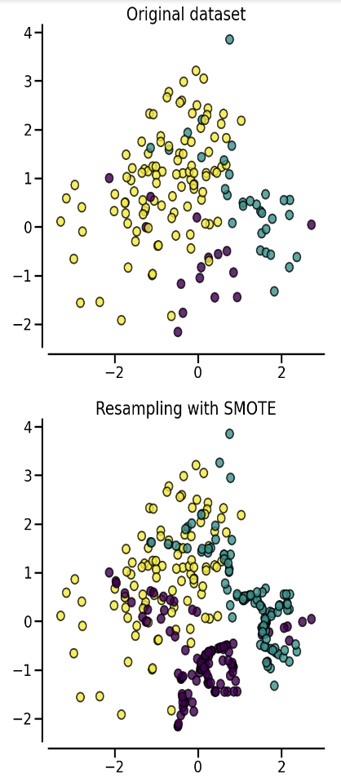
Machine learning
Imbalanced sample problem
Synthetic Minority Oversampling Technique (SMOTE) generate new samples in by interpolation between known class label sources.
14

Slide 16

Machine learning. Problems
All-time problems:
Overfitting
Feature engineering
Training set's purity
Not enough data for the test
15

Slide 17
Counterpart Identification
&
Source Classification
16

Slide 18
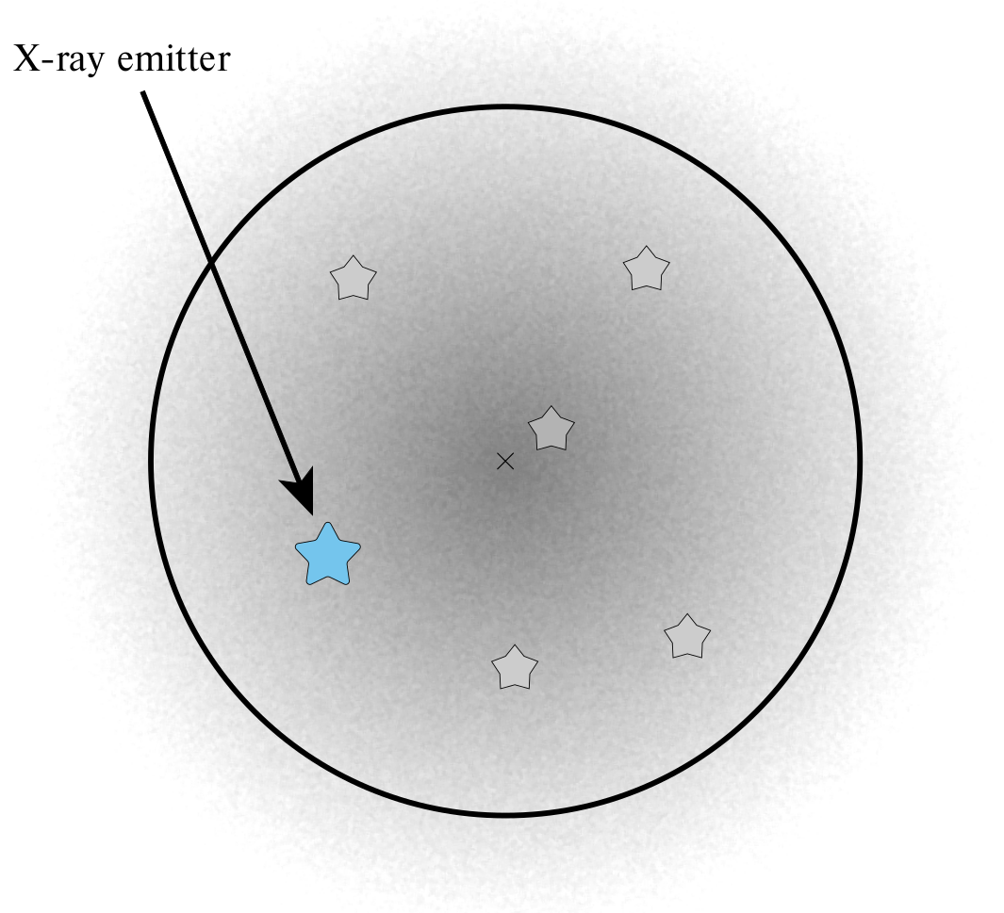
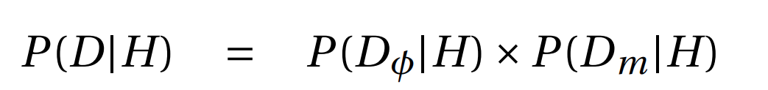
Identification of the optical/IR counterpart
Bayesian framework (NWAY):
- Likelihood based on geometrical positions
- Likelihood based on photometric data​
Salvato et. al. (2018)
Budavári&Szalay (2008)
17

Slide 19
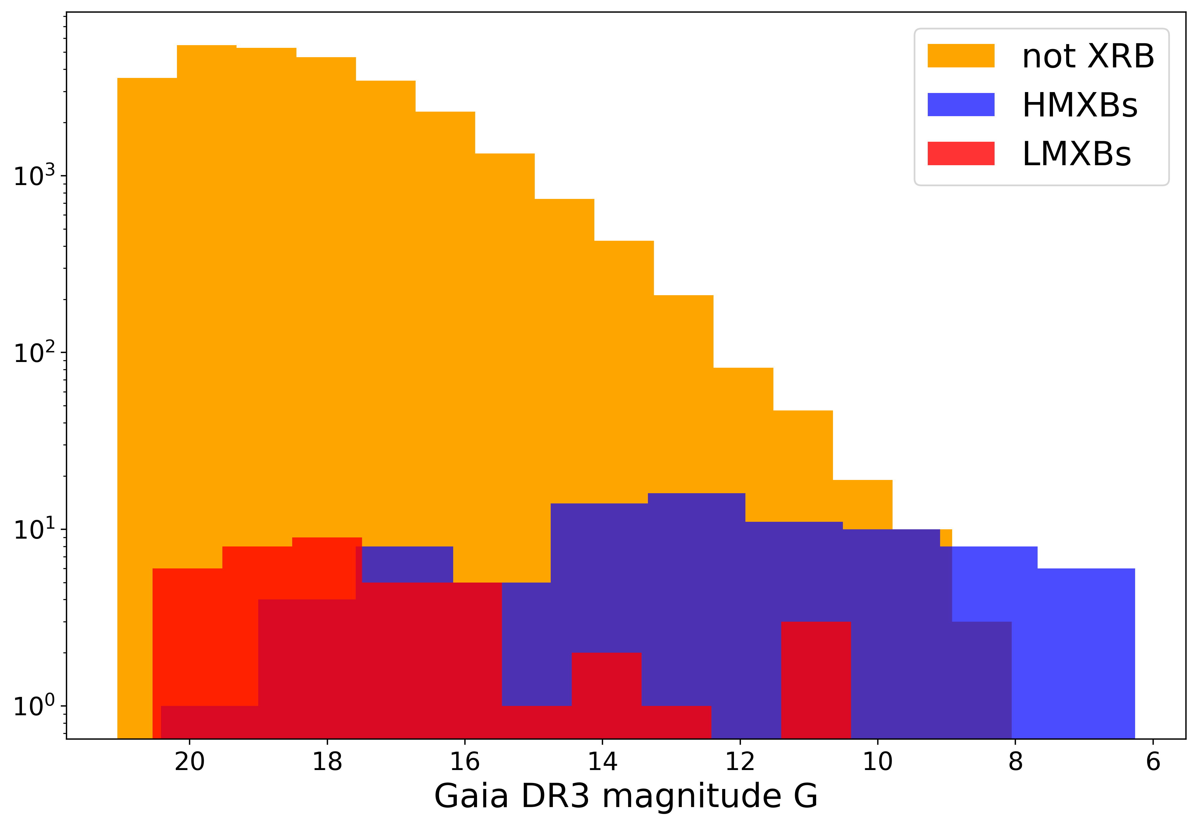
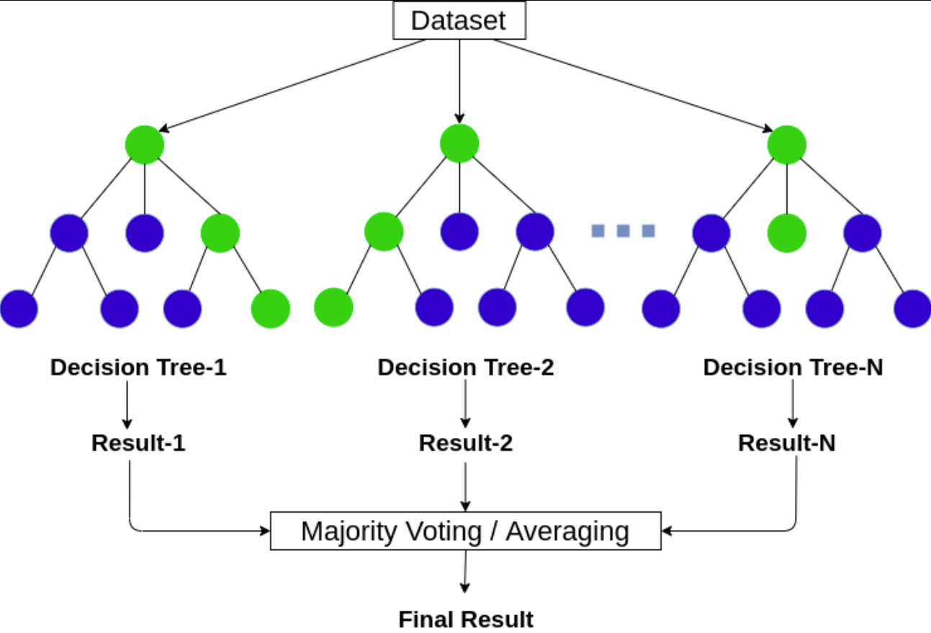

Identification of the optical counterpart
Machine learning approach
+
distances, magnitudes, colours, etc
P_XRAY_CTPT
18

Slide 20
Identification of the optical counterpart
Machine learning approach
+
distances, magnitudes, colours, etc
+
Xray features
P_XRAY_CTPT
(repeat classification) → P_XRAY_SOURCE
18

Slide 21
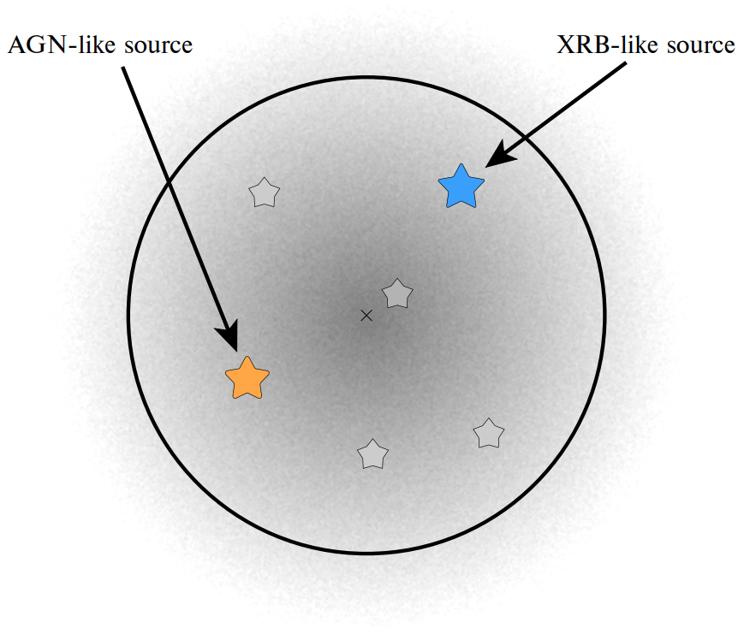
Identification of the optical/IR counterpart
Discrimination from AGNs
Huge imbalance!
Problem:
AGN-like optical/IR sources are preferred as counterparts
19

Slide 22
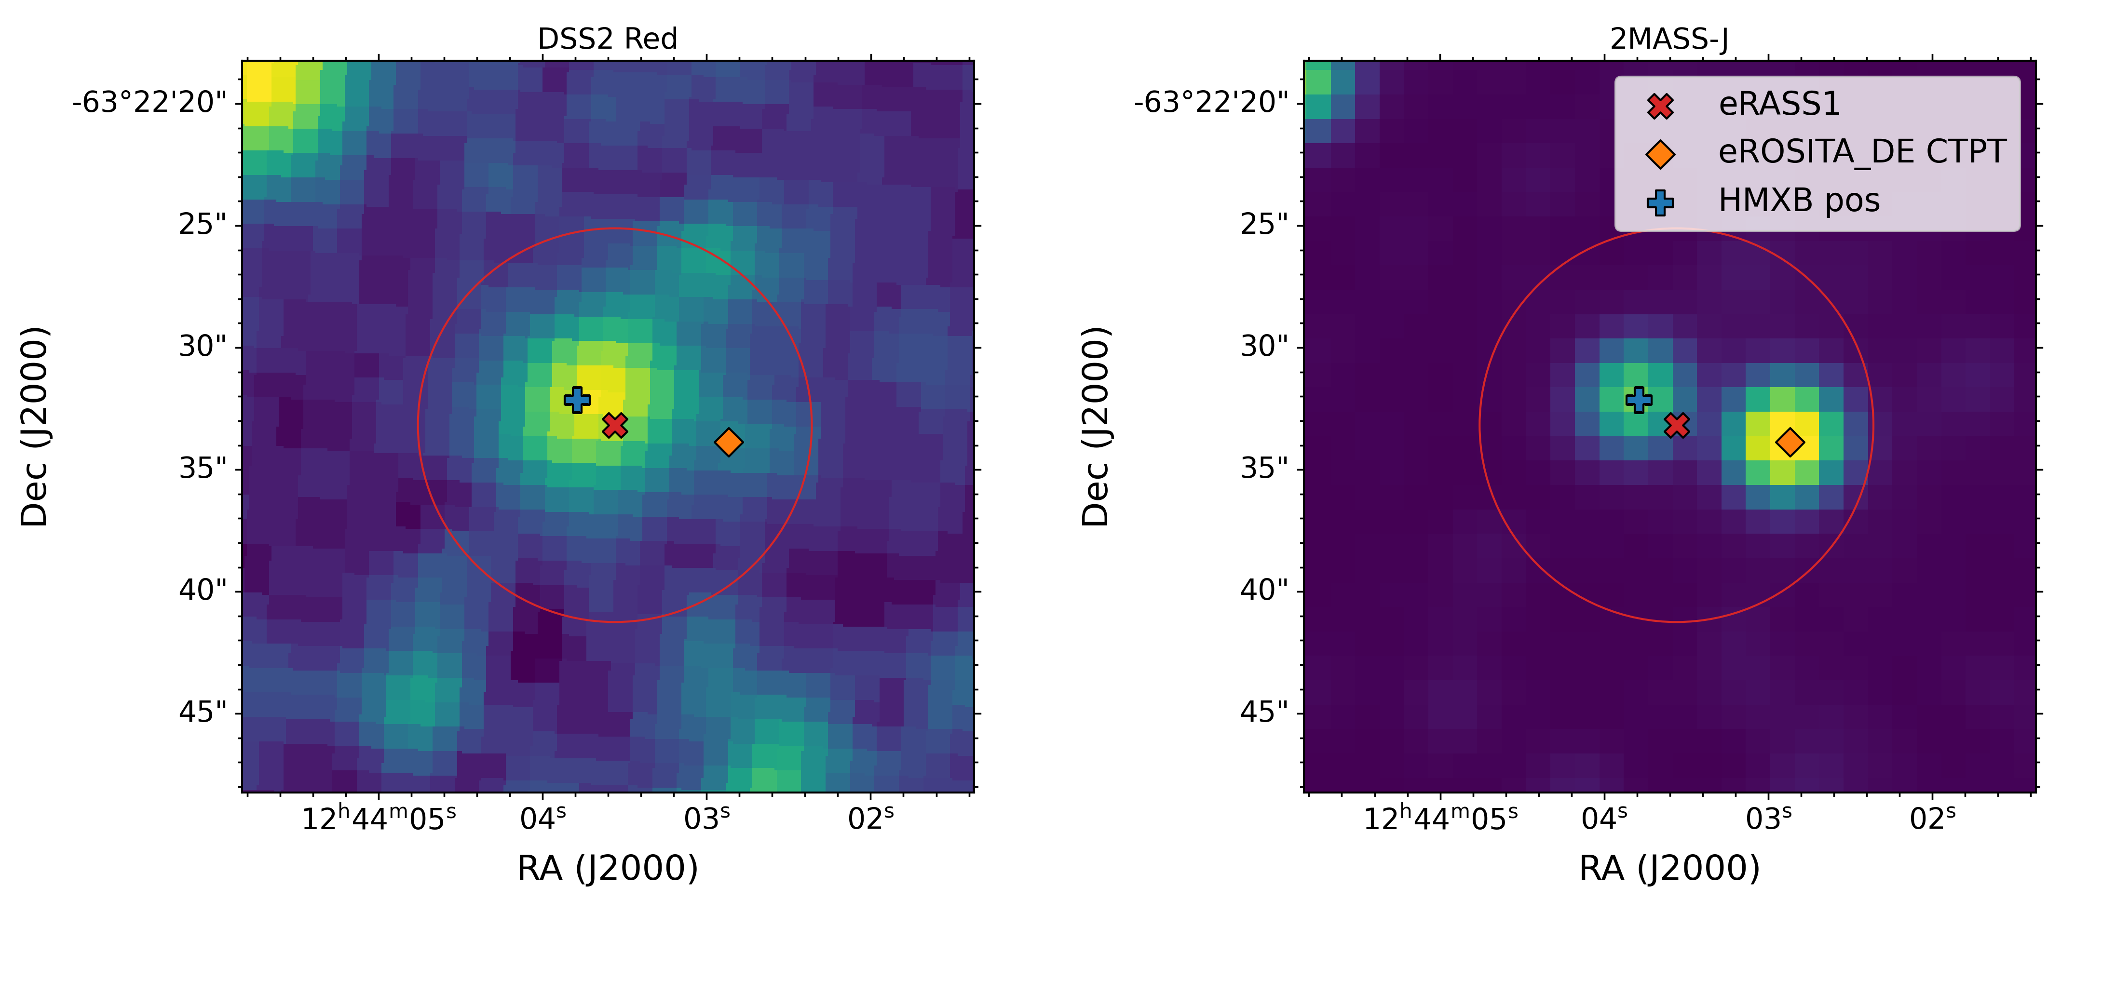
Identification of the optical/IR counterpart
Discrimination from AGNs
An optical/IR view of view HMXB SRGA J124404.1-632232
Optical counterparts are incorrectly identified for ~30% of XRBs
20

Slide 23
Identification of the optical counterpart
Machine learning approach
+
distances, magnitudes, colours, etc
+
Xray features
P_HMXB_CTPT (repeat classification) → P_HMXB, ...
P_LMXB_CTPT (repeat classification) → P_LMXB, ...
21

Slide 24
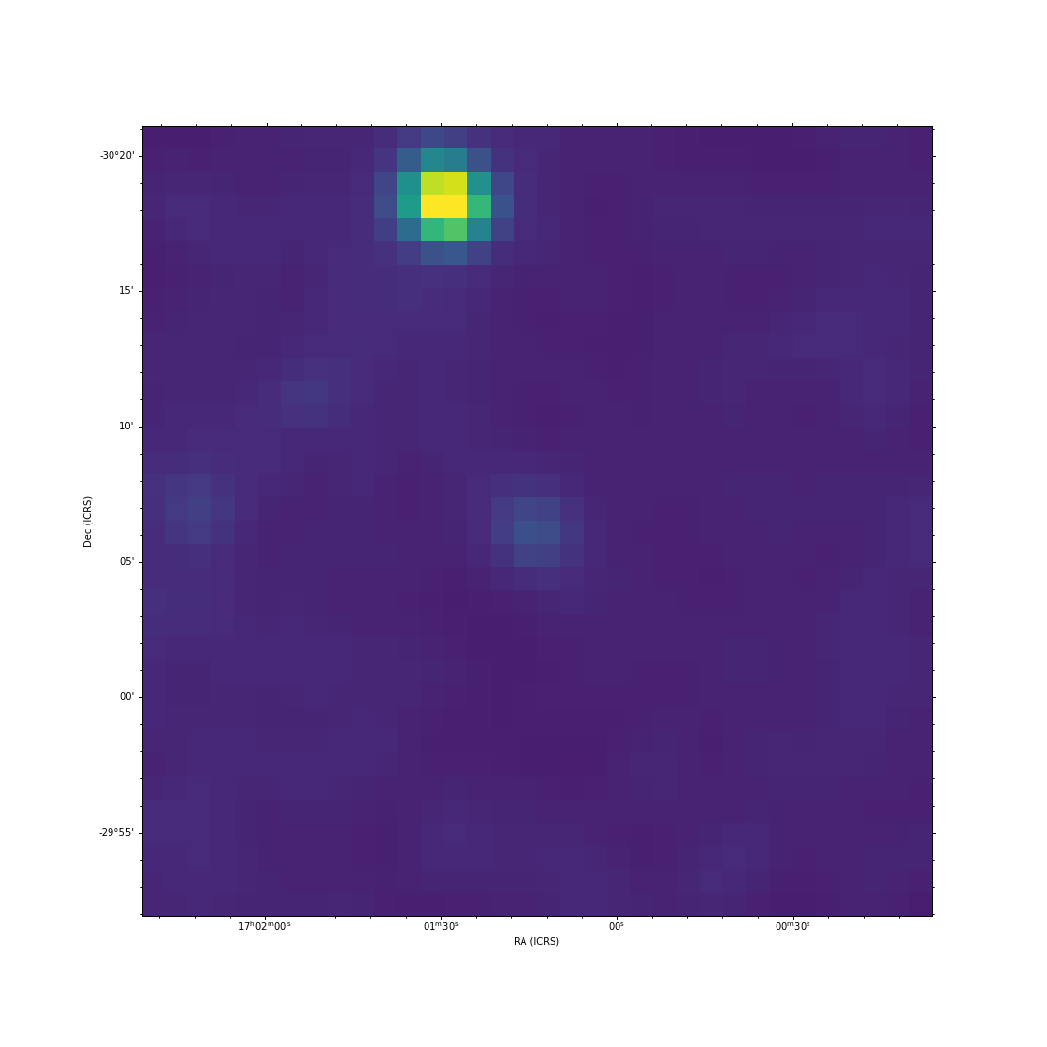




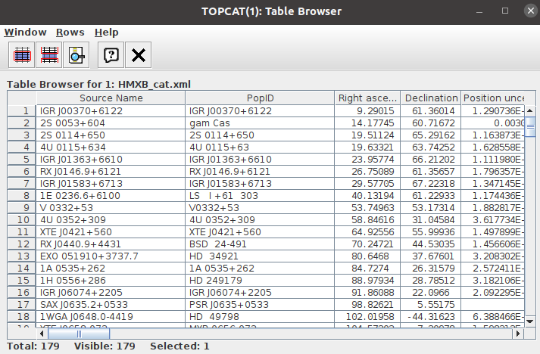
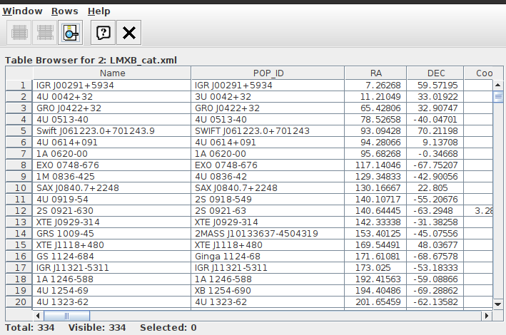
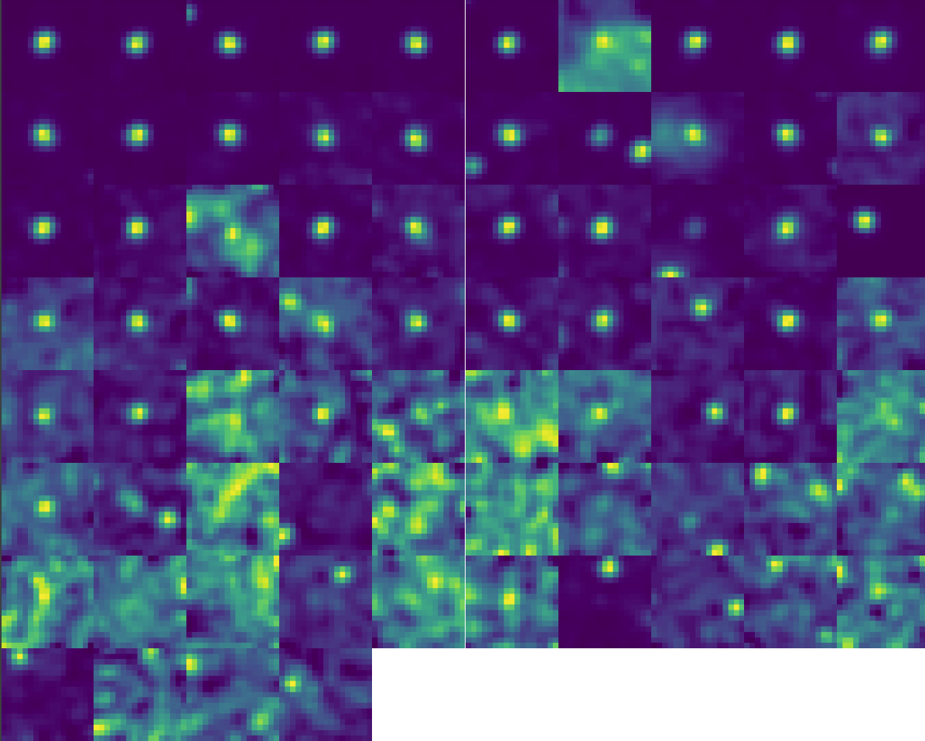
Classification X-ray sources
Features:
1. G band magnitude
2. BP band magnitude
3. RP band magnitude
5. J band magnitude
6. H band magnitude
7. K band magnitude
8. W1 magnitude (3.35um)
9. W2 magnitude (4.6um)
10. Nh column
11. X-ray flux (0.2-2.3 keV)
12. X-ray flux (2.0-8.0 keV)
13. Fluxes significance
14. Distance
15. Distance significance
Gaia DR3
Classes/labels:
1. HMXBs
2. LMXBs
3. X-ray emitting INSs (magnetars, pulsars, CCOs)
4. CVs
5. WR
6. AGN
7. Early type stars (O-B, Be, Gamma Cas),
8. Evolved stars (Chromo-active mostly)
9. YSOs
2MASS/VVV
CatWISE2020
Doroshenko et al (2024)
eRASS1M
22

Slide 25
List of catalogs used for labeling X-ray sources
1. J/ApJS/221/12/table1
2. J/AJ/133/313/AGN
3. J/AJ/133/313/BAL
4. VII/283/catalog
5. J/MNRAS/405/2062/AGNs
6. B/cb/cbdata
7. V/110/catalog
8. vizier:V/123A/cv
9. J/ApJ/901/3/catalog
10. J/MNRAS/493/2438/sed
11. J/ApJS/242/4/table3
12. J/ApJS/242/4/table5
13. VII/274/bzcat5
14. J/AN/340/437/table8
15. J/A+A/632/A77/3hsp-v9
16. J/A+A/641/A62/table1
17. J/AJ/133/313/BLLac
17. J/AJ/133/313/BLLac
18. J/ApJ/902/114/table2
19. J/A+A/551/L8/cacomp
20. J/A+A/616/A108/catalog
21. J/MNRAS/443/2561/stars
22. J/MNRAS/458/3479/clasi-ii
23. J/A+A/506/1055/table1
24. J/MNRAS/482/4570/gaia2wd
25. III/67A/catalog
26. J/PASP/126/219/table3
27. V/125/obcat
28. J/ApJS/241/32/table3
29. J/MNRAS/446/274/catalog
30. III/274/main
31. J/ApJS/144/21/stars
32. J/ApJS/224/4/table5
33. III/215/table13
34. J/ApJS/254/33/table1
35. J/ApJ/695/511/table2
35. J/AJ/144/192/table4
36. J/A+A/542/A66/YSOs
37. J/A+A/487/253/table2
38. J/ApJ/743/166/table2
39. B/psr/psr
40. Chen et al (2019)
LMXB catalog
(Avakyan et al 2023)
HMXB catalog
(Neumann et al 2023)
23

Slide 26
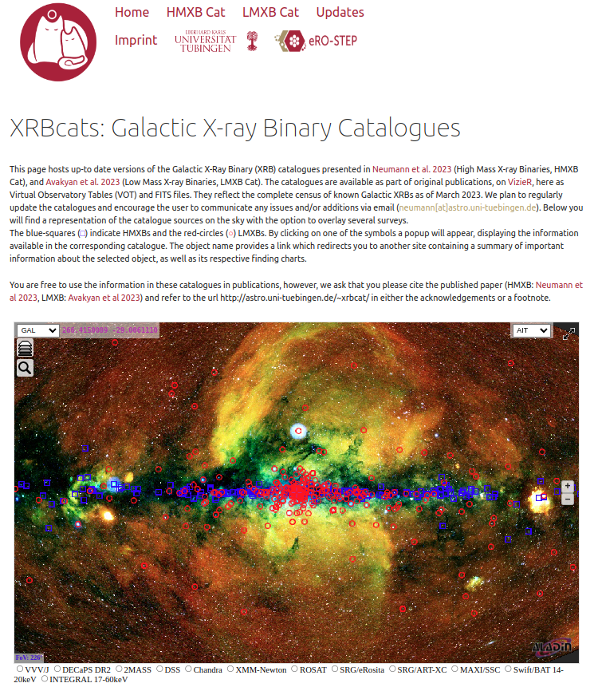
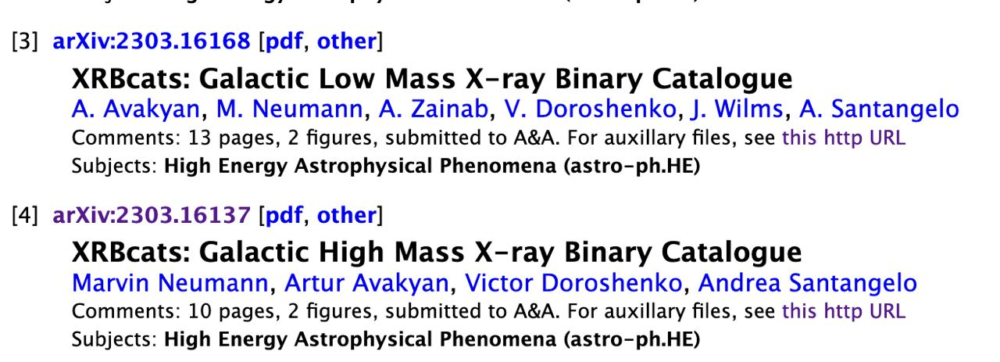
Updated XRB catalogues
http://astro.uni-tuebingen.de/~xrbcat
24

Slide 27
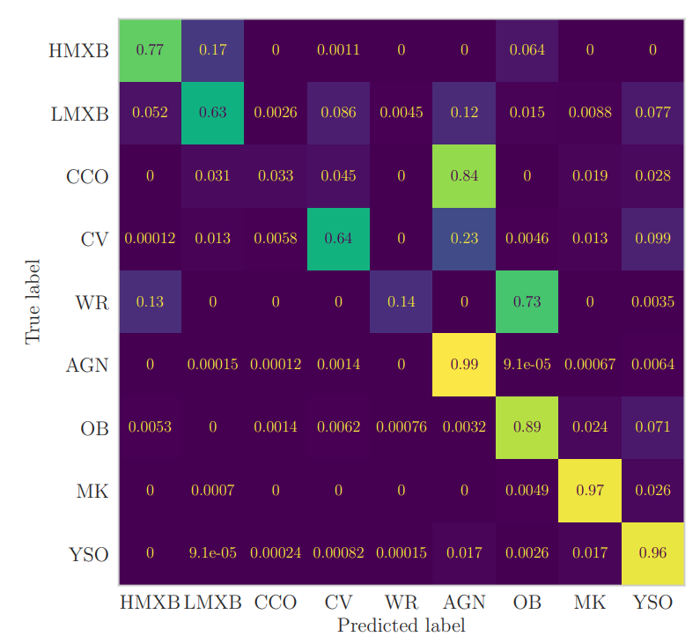
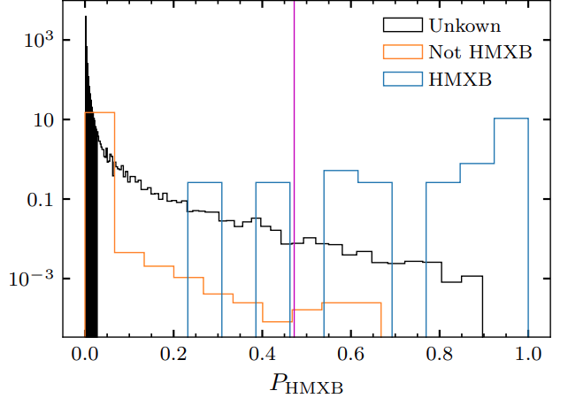

ML classification results
Selecting plausible candidates
Completness = 0.7
Purity = 0.83
Prob_cut = 0.472
HMXB Candidates: 97
25

Slide 28
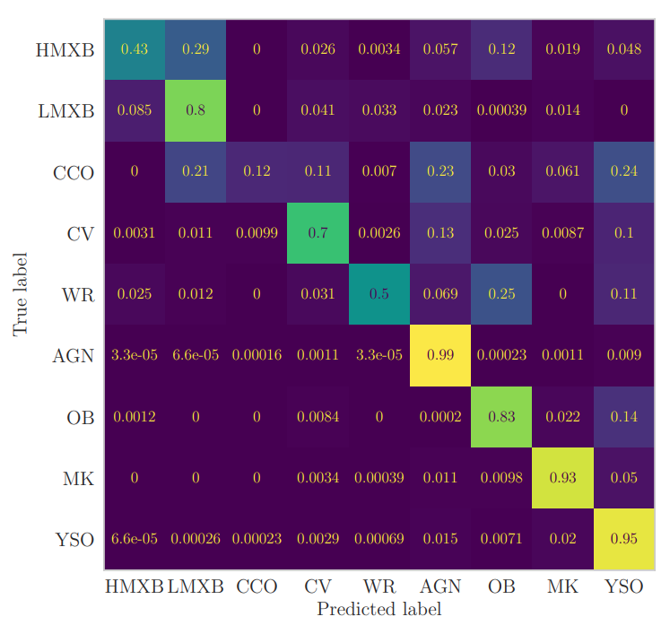
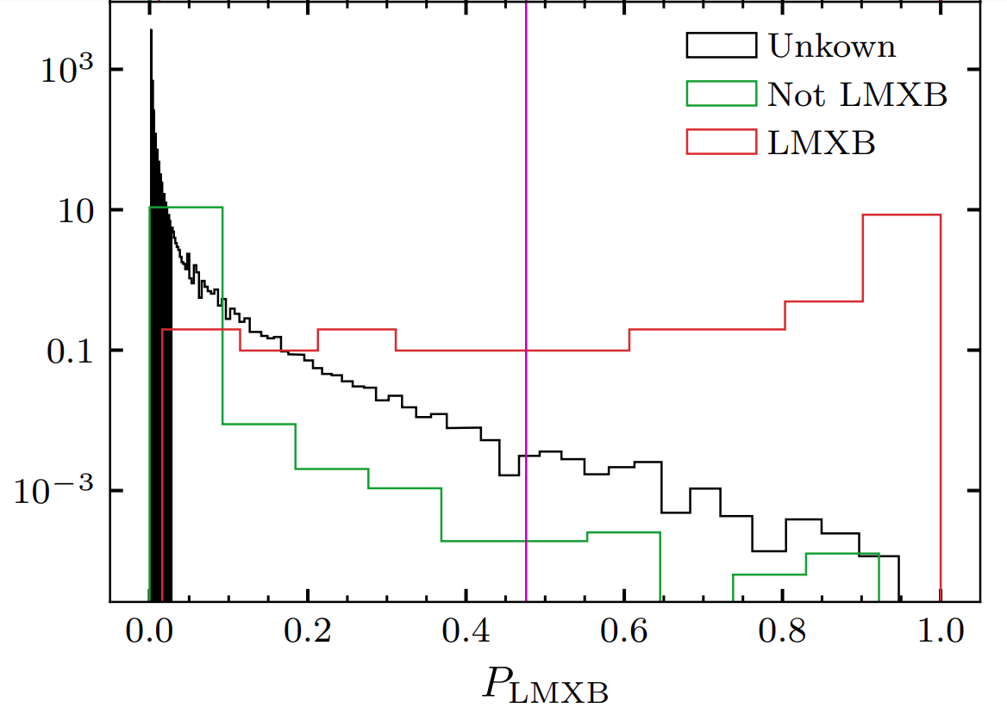
ML classification results
Selecting plausible candidates
Completness = 0.7
Purity = 0.76
Prob_cut = 0.472
HMXB Candidates: 94
26

Slide 29
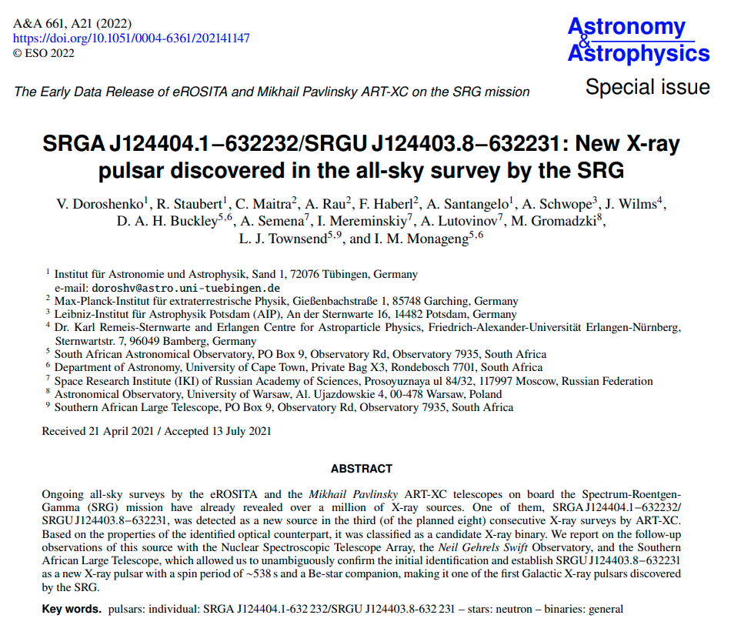
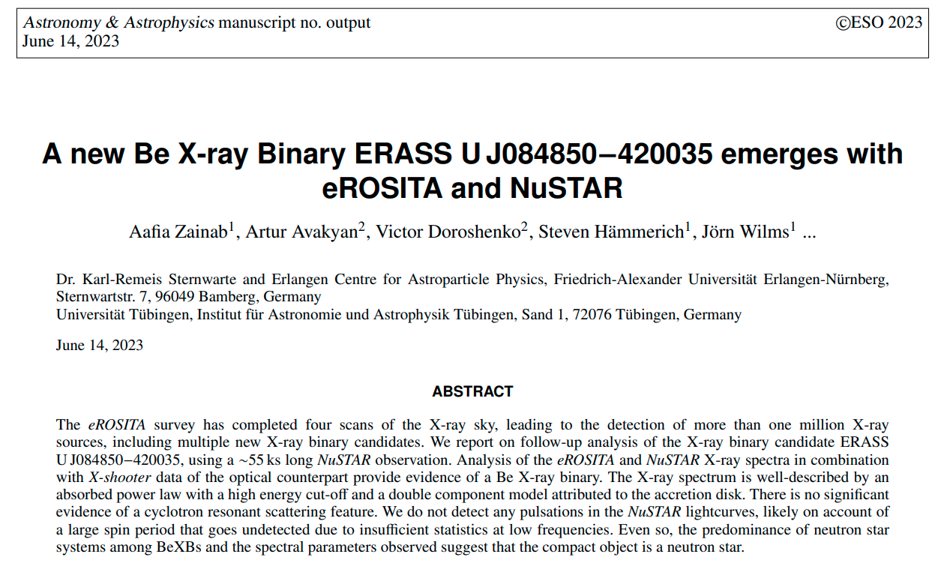
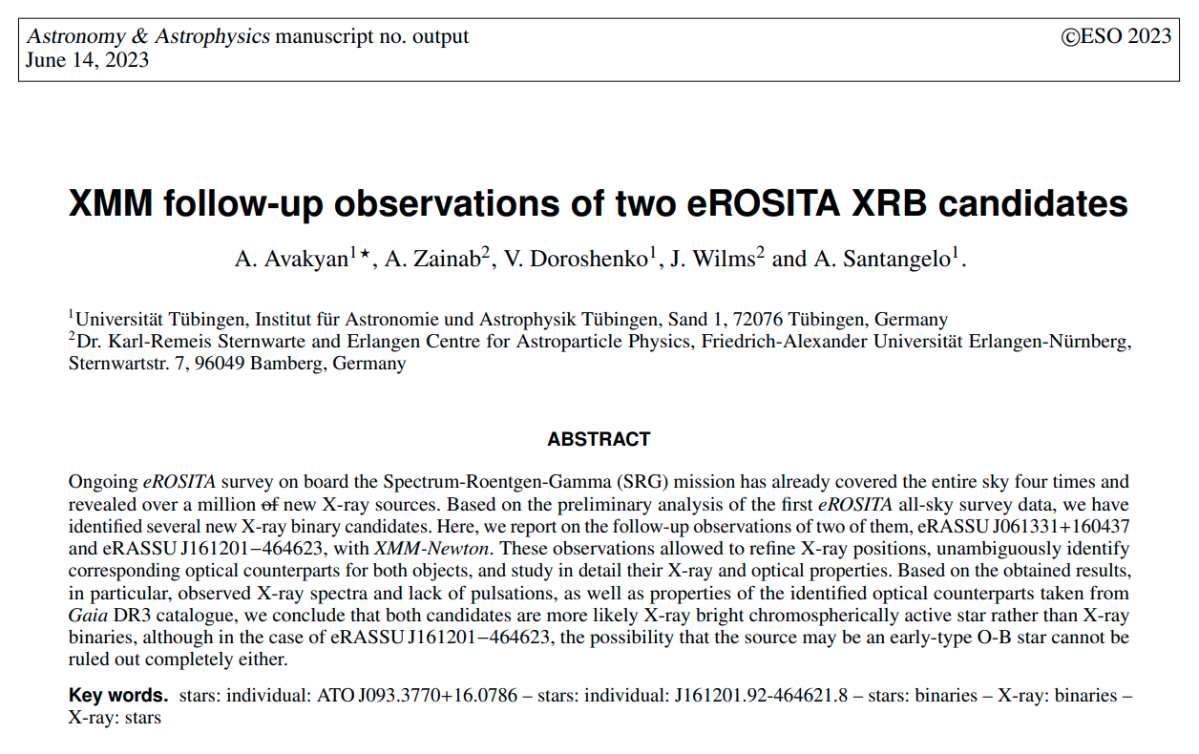

Follow-up verification of candidates
Additionally 7 XRBs
(4 HMXBs and 3 LMXBs)
will be follow-uped:
1. XMM (125ks granted)
2. NuSTar (150ks granted)
29

Slide 30
Thank you for your attention!

Slide 31
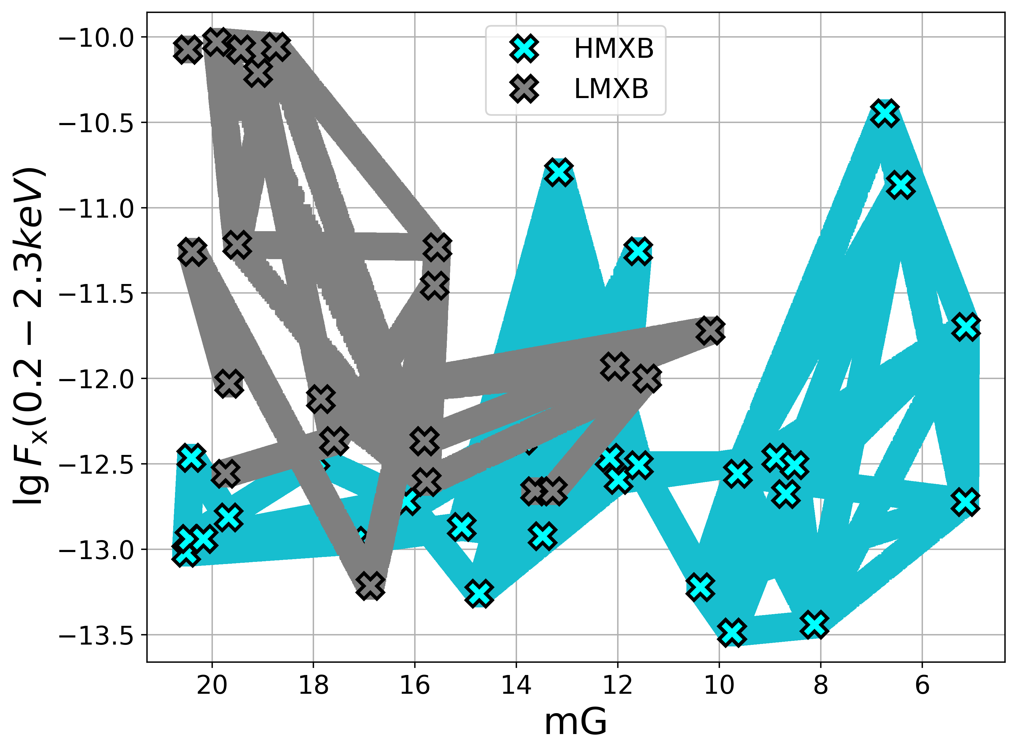
Imbalanced sample problem
Data augmentation
Synthetic Minority Oversampling Technique (SMOTE) generate new samples in by interpolation between known class label sources.

